Slide 1

Video Game Popularity Project
Descriptive Data Analysis for GameCo
Nonso Ezeoma

Slide 2

INTRODUCTION
PROJECT OVERVIEW
The Video game popularity Data project analyses historical video game sales to provide GameCo with insights for strategic decision-making
PROJECT OBJECTIVES
Identify Popular games Genres
Assess Competitive Landscape
Track Popularity Trends
Regional Sales Analysis
PURPOSE
This Project was created as part of my Data analytics course at CareerFoundry to demonstrate Mastery of Descriptive Data Analysis Development

Slide 3

PROBLEM STATEMENT
Current Understanding
Key Questions
1
2
GameCo Needs to understand which types of video games are most popular, identify main competitors, and analyze sales trends across different regions to make informed decisions on game development and marketing strategies
GameCo’s Executives assumed that sales for the various geographic regions have stayed the same over time

Slide 4
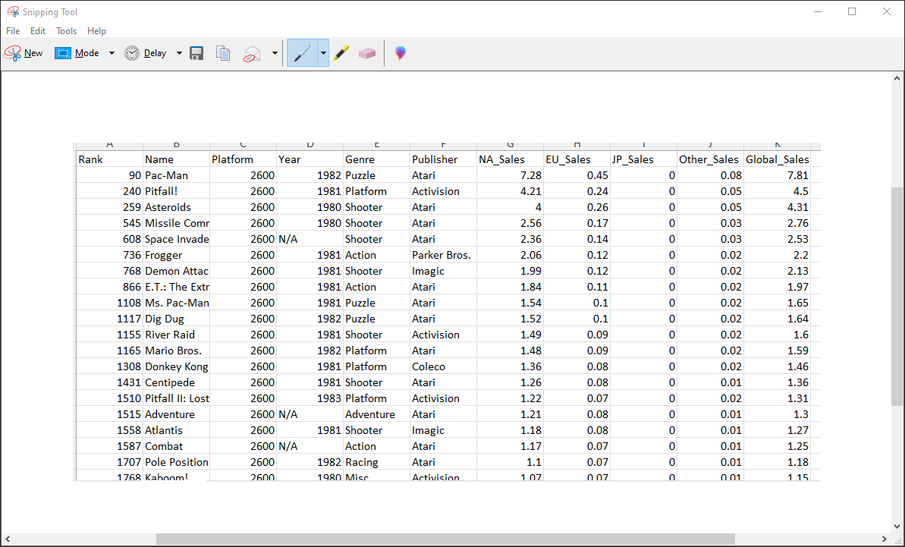
DATA OVERVIEW
- Data Source: VGChartz (1980-2016)
- Scope: Sales figures for games with over 10,000 copies sold
- Units: Sales represented in millions
Key Variables
- Game Title
- Platform
- Year
- Genre
- Publisher
- NA Sales
- EU Sales
- JP Sales
- Other Sales
- Global Sales
Download the video game sales data set (1980-2016)

Slide 5
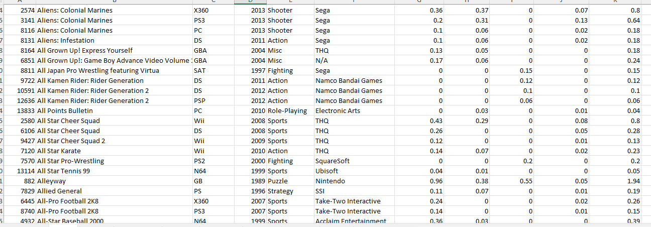
METHODOLOGY
I used data cleaning techniques to clean a ‘dirty’ version of the video game sales data. There are several blanks in the columns. I removed the rows containing data without Vital information like Name, Year, Publisher, and platform. Rows containing only value data do not meet the criteria for substantial analysis. I removed duplicates and handled missing values by correcting inaccuracies.
TOOLS
Excel
SKILLS
Sorting and filtering
Creating Pivot tables
Grouping Data
Summarizing Data
Descriptive Data Analysis
Created Visualizations
Insights development
Presentation of Findings
Notes:
dfhhjjj

Slide 6
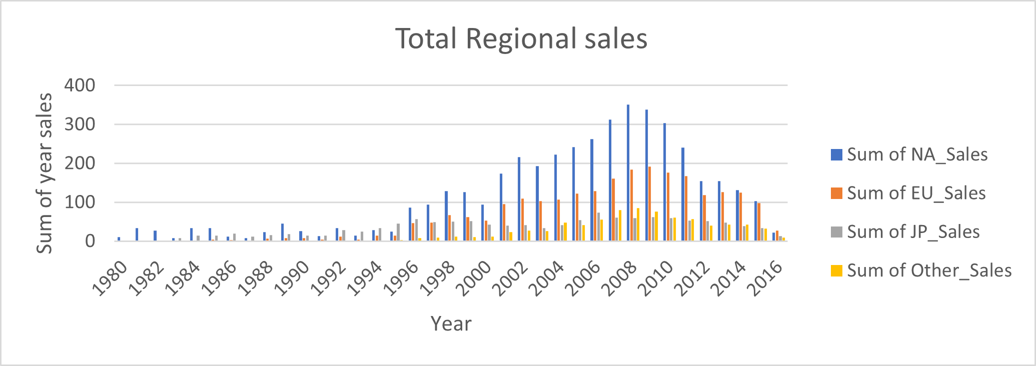
SUMMARY STATISTICS
To analyze whether sales for the geographic regions (North America, Europe, Japan, and other regions) have stayed the same over time from 1980 to 2016, a time series analysis on the sales data (as-it-is) should first be performed. This time series analysis should act as a first-stage statistical method to use to examine patterns and trends in data over time.

Slide 7
MARKET TRENDS
Using this stacked bar chart, I was able to derive insights that ‘shooter and Action’ games genre has enjoyed decisive popularity among others in terms of regional sales. Strategy games have the lowest popularity in regional sales.

Slide 8
MARKET TRENDS
The highest peak occurred in 2008 then following a decline in game sales. The observed data indicates that North America dominates the market with a much higher sales proportion than Europe and Japan. Here I used recent data from 2008 to 2016 to have a better prediction of current trends

Slide 9
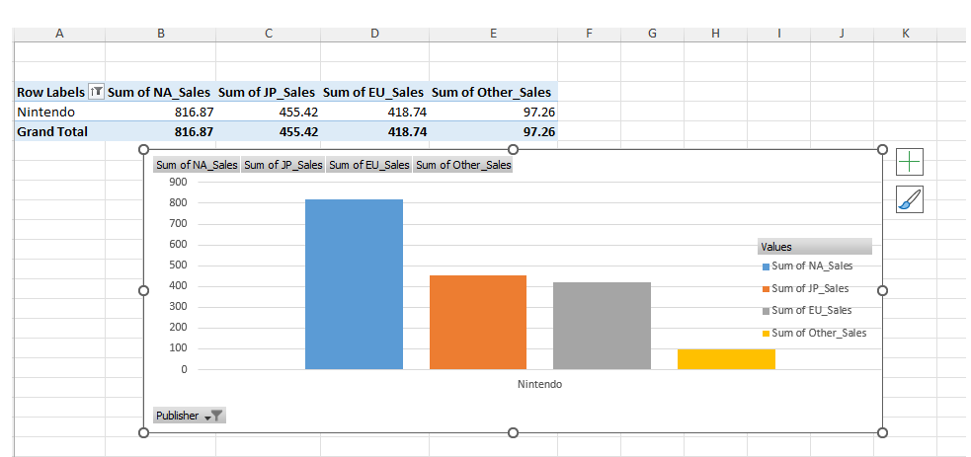
Market Trends
Publisher Nintendo has the highest sales volume across all regions and will likely remain the main competitor

Slide 10
DESCRIPTIVE ANALYSIS
It will be valuable to add that in the most recent year 2016, Europe had the largest sales in comparison to each region

Slide 11
Insights and Findings
Popular Game Genres:
- Shooter and Action games are the most popular genres across all regions.
- Sports and Platform games also show significant popularity, especially in North America and Europe.
- Role-playing games are particularly popular in Japan.
Regional Sales Trends:
- North America consistently dominates the market with the highest sales proportions. From 2008 to 2016, NA sales peaked in 2008 at 351.40 million units but showed a declining trend, reaching 22.66 million units in 2016.
- Europe showed steady sales, with a peak in 2008 at 184.40 million units and a gradual decline to 26.75 million units in 2016.
- Japan had lower sales compared to NA and Europe, with a peak of 61.71 million units in 2009 and a decline to 13.65 million units in 2016.
- Other regions showed the least sales, peaking at 84.74 million units in 2008 and decreasing to 8.96 million units in 2016.

Slide 12
Insights and Findings
- Japan had lower sales compared to NA and Europe, with a peak of 61.71 million units in 2009 and a decline to 13.65 million units in 2016.
- Other regions showed the least sales, peaking at 84.74 million units in 2008 and decreasing to 8.96 million units in 2016.
Competitive Landscape:
- Nintendo is the leading publisher across all regions, with the highest sales volumes.
- Other significant competitors include Electronic Arts (EA) and Activision Blizzard, particularly strong in North America and Europe.
Market Dynamics:
- Sales data from 2008 to 2016 indicates shifting trends, with North America and Europe showing declining sales, possibly due to market saturation or shifting consumer preferences.
- Japan’s market shows a preference for role-playing games, which can be a niche focus for GameCo.

Slide 13
Recommendations
. Focus on Popular Genres:
- Prioritize developing and marketing Shooter and Action games to capture a significant share of the popular genres.
- Consider creating Sports and Platform games to appeal to a broad audience in North America and Europe.
Regional Marketing Strategies:
- North America: Focus on maintaining dominance in Shooter and Action genres. Invest in innovative marketing strategies to counteract the declining trend.
- Europe: Tailor marketing campaigns to highlight popular genres like Shooter, Action, and Sports games.
- Japan: Develop and market Role-Playing games to cater to local preferences. Collaborate with local influencers to boost market presence.
Competitive Positioning:
- Analyze strategies of top competitors like Nintendo, EA, and Activision Blizzard.

Slide 14
Insights and Findings - Appendix
Genre | NA Sales (million) | EU Sales (million) | JP Sales (million) | Other Sales (million)
Shooter | 582.59 | 313.26 | 38.28 | 103.09
Action | 877.82 | 524.99 | 159.95 | 192.79
Role-Playing | 327.27 | 188.06 | 352.30 | 63.21
Region | Peak Sales (million) | Peak Year | Sales in 2016 (million)
North America | 351.40 | 2008 | 22.66
Europe | 184.40 | 2008 | 26.75
Japan | 61.71 | 2009 | 13.65
Other Regions | 84.74 | 2008 | 8.96
Publishers/Competitors | Region | Comment
Nintendo | All Regions | Highest sales volumes
Electronic Arts (EA) | NA, Europe | Strong competitor
Activision Blizzard | NA, Europe | Strong competitor

Slide 15
Recommendation Appendix
Strategy | Details
Focus on Popular Genres | Shooter: NA (582.59m), EU (313.26m), JP (38.28m), Other (103.09m)
 | Action: NA (877.82m), EU (524.99m), JP (159.95m), Other (192.79m)
Regional Strategies | NA: Maintain dominance in Shooter and Action genres.
 | EU: Highlight popular genres like Shooter, Action, and Sports games.
 | JP: Market Role-Playing games and collaborate with local influencers.
Competitive Positioning | Differentiate from Nintendo, EA, and Activision Blizzard. Invest in exclusive content.
Adapt to Market Changes | Monitor sales trends and preferences. Adjust strategies and explore new markets.

Slide 16
CHALLENGES FACED
I particularly found the data-cleaning process quite tedious and time-consuming considering that it contained inconsistencies and needed serious decisive action. For example, I had to remove some missing variables, and some columns were blank. However, in the process, I learned a great deal of data cleaning and wrangling which is an essential skill in the job of a data analyst.
FUTURE STEPS
To ensure GameCo continues to leverage data for strategic decision-making and stays ahead in the competitive video game market, I would consider the following future steps:
Explore Data Sources by incorporating additional data sources such as reviews, social media sentiment
Continuously monitoring Sales data and market trends to stay informed of changes and adapt strategies accordingly

Slide 17




MANY THANKS!
I hope you find my work interesting. Let’s connect and work smart!
CREDITS: This presentation template was created by Slidesgo, including icons by Flaticon

Slide 18

A PICTURE IS WORTH A THOUSAND WORDS

